Slide 1
Human-Robot Interaction:
Attention System 1
by Dr. Katrin S. Lohan
*Multiple slides over the course adapted form T. N. Vikram@ University Bielefeld

Slide 2
Attention
Attention is the behavioural and cognitive process of selectively concentrating on a discrete aspect of information, whether deemed subjective or objective, while ignoring other perceivable information.
Attention has also been referred to as the allocation of limited processing resources.

Slide 3

Attention
Visual Attention
Audio Attention
Joint Attention

Slide 4
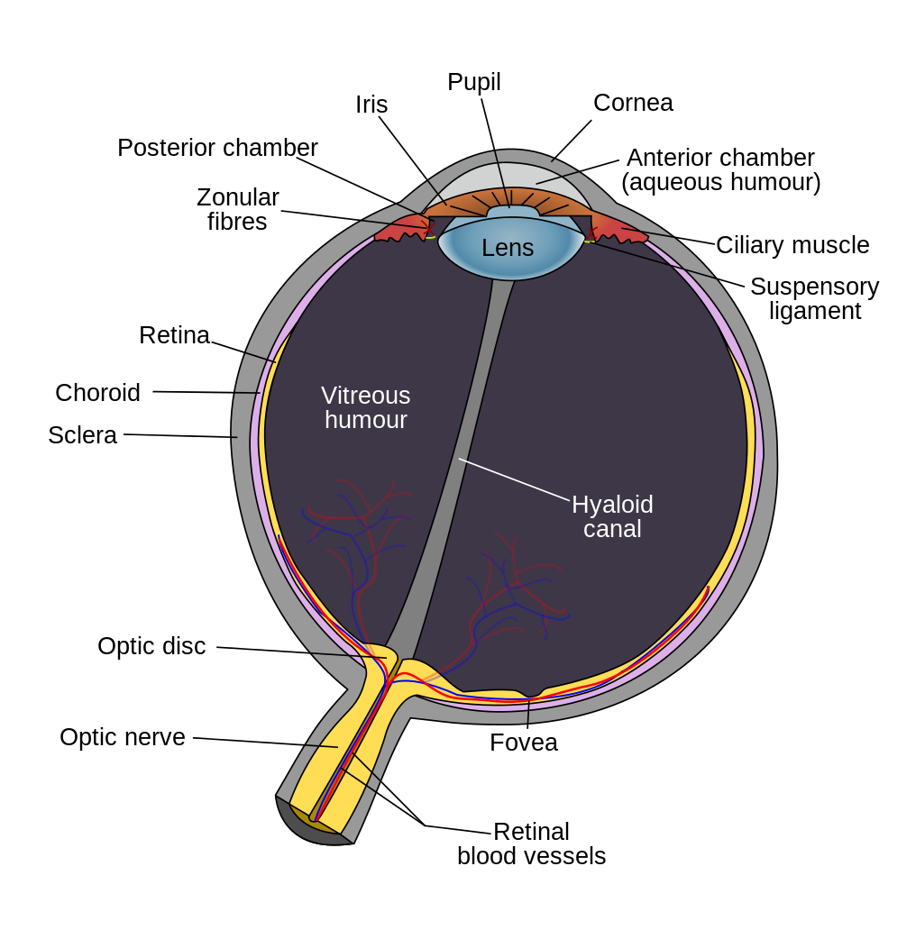
Visual Attention
Defined by Cognitive Phycology
Visual attention a two-stage process [1]:
attention is distributed uniformly over the external visual scene
attention is concentrated to a specific area of the visual scene (i.e. it is focused)
This focusing process can be explained by the Fovea
small central pit composed of closely packed cones
fovea is responsible for sharp central vision (also called foveal vision)

Slide 5
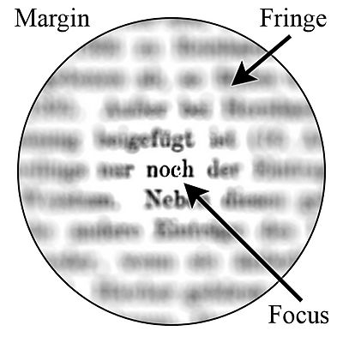
Visual Attention
Computer vision:
modelling the mechanism of human attention
bottom-up attentional mechanism
mimic the bottom-up process through saliency mechanism [2]

Slide 6
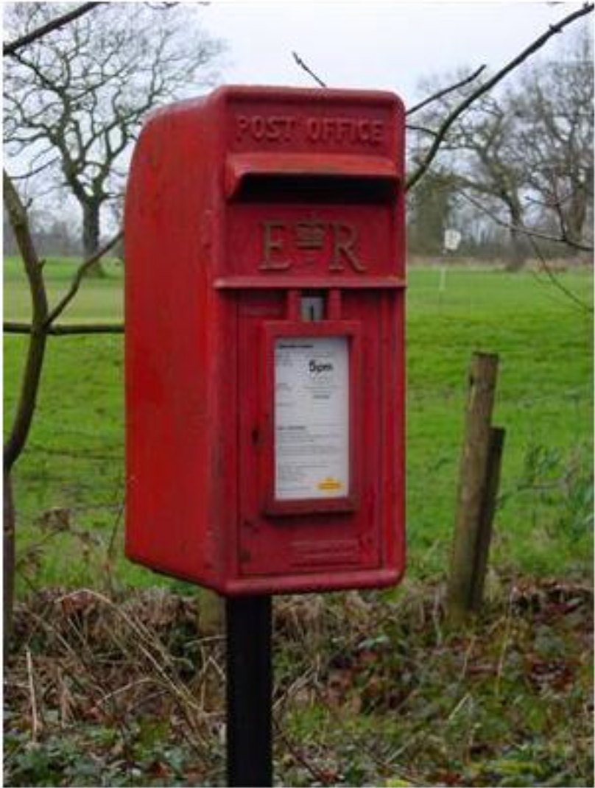
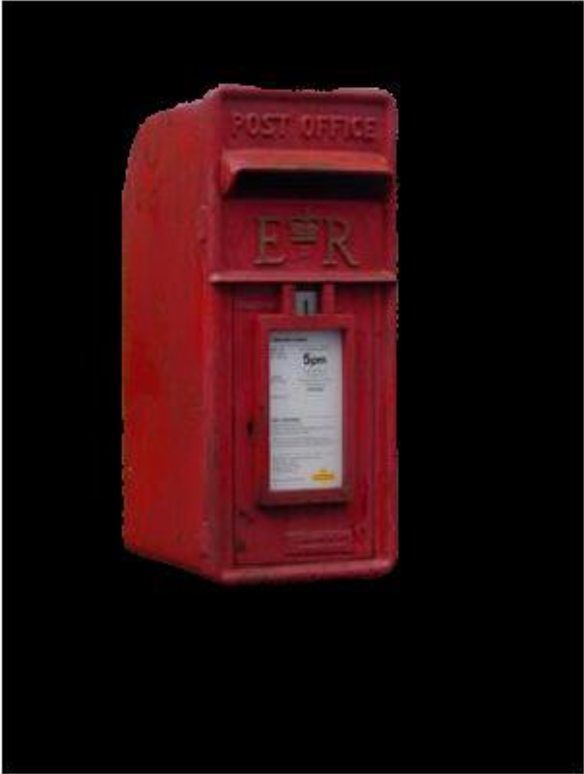
Computational Modelling of Visual Attention
What is Visual Attention?

Slide 7
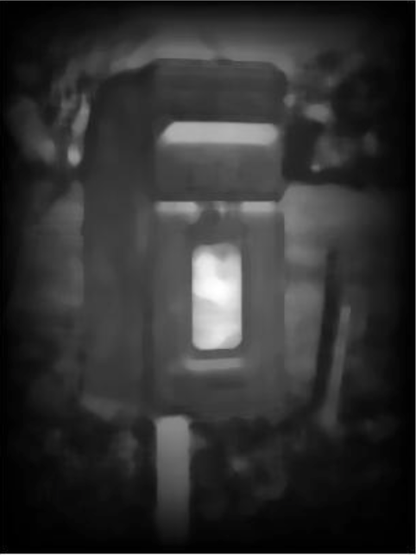
Saliency Map

Slide 8

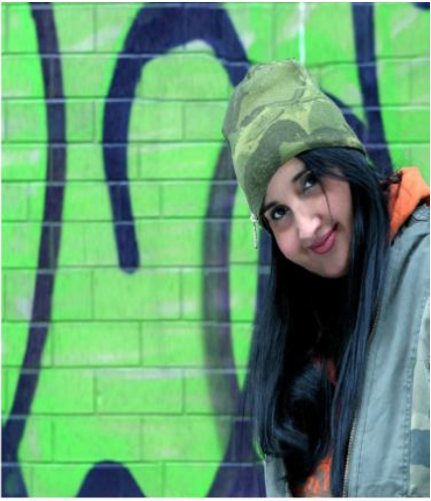

Applications
Resized without Resized with
Saliency Saliency

Slide 9
Other Applications
Video Retargeting
Image quality assessment
Aesthetics analysis
Robot eye-gaze control
Image segmentation
and off late, Object detection, recognition and localisation

Slide 10
Existing Approaches
Multiscale image analysis
Entropy
Self-Similarity
Center-Surround approach
Distance transform
Global Contrast
Symmetry
Local steering kernels
Graphical model

Slide 11
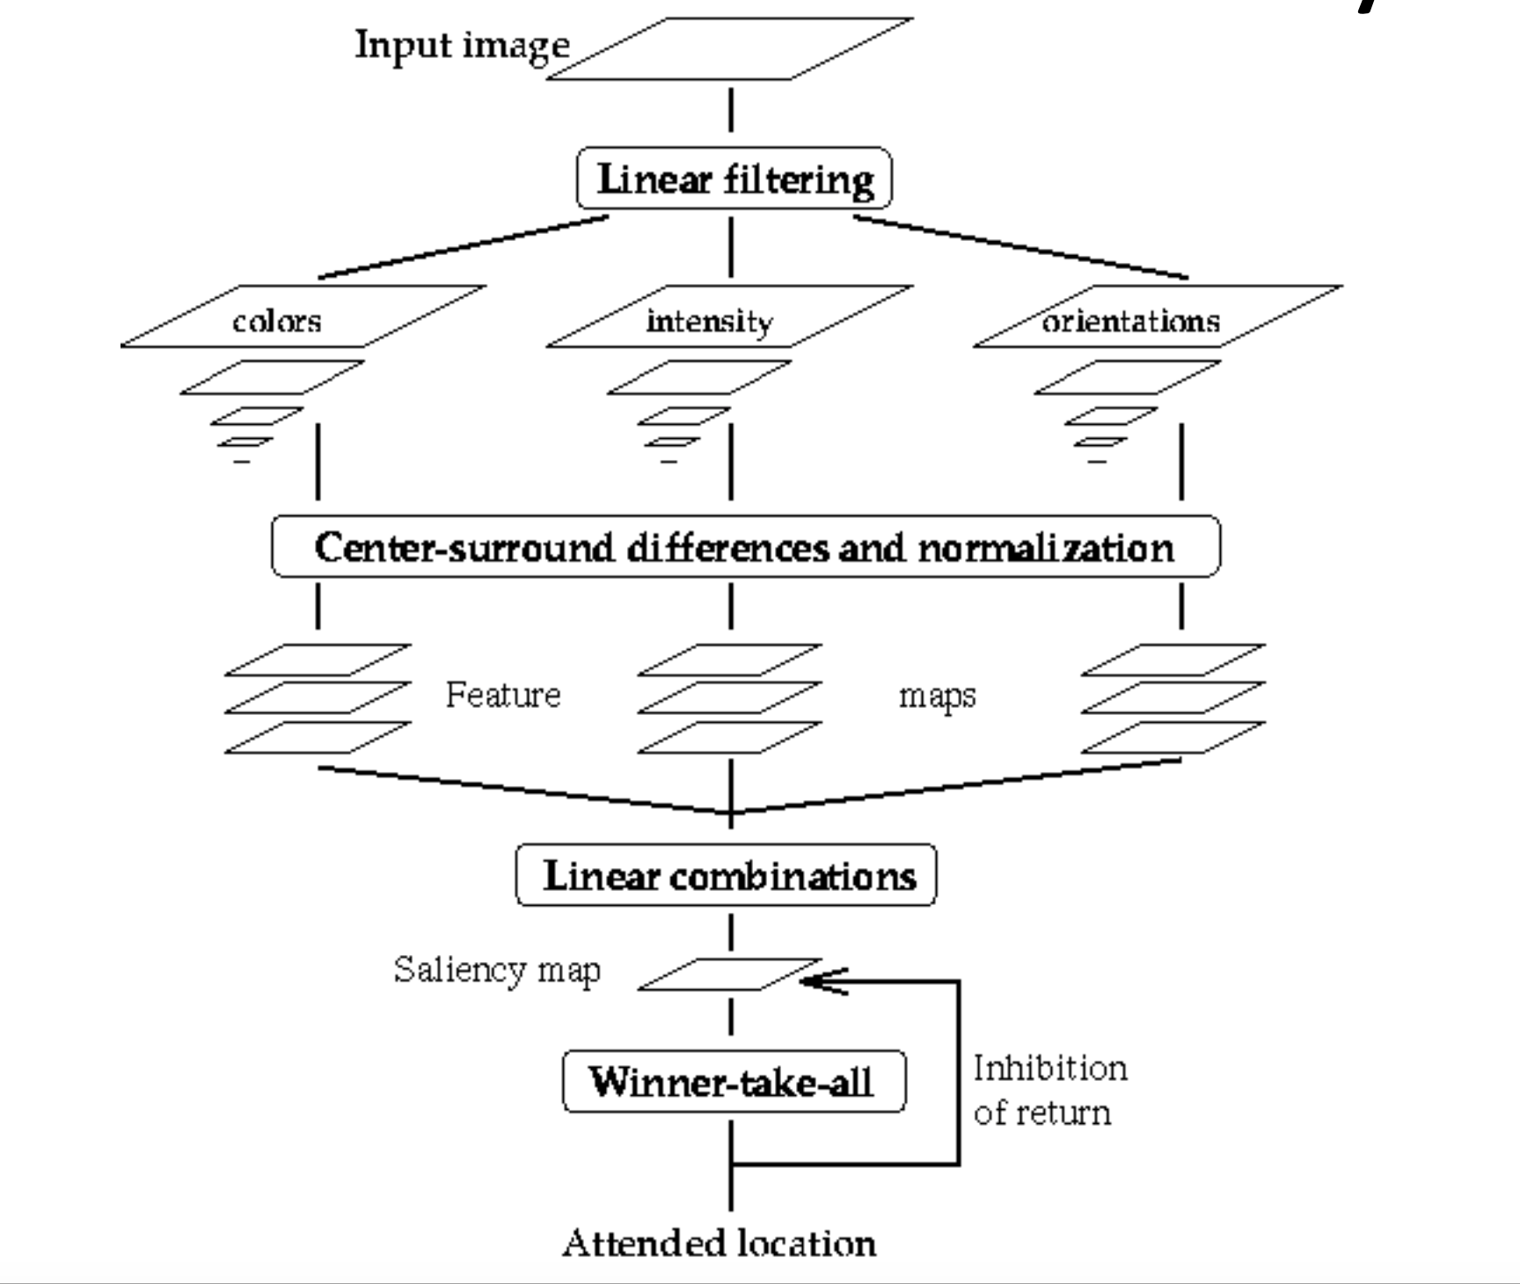
Multiscale Visual Saliency

Slide 12
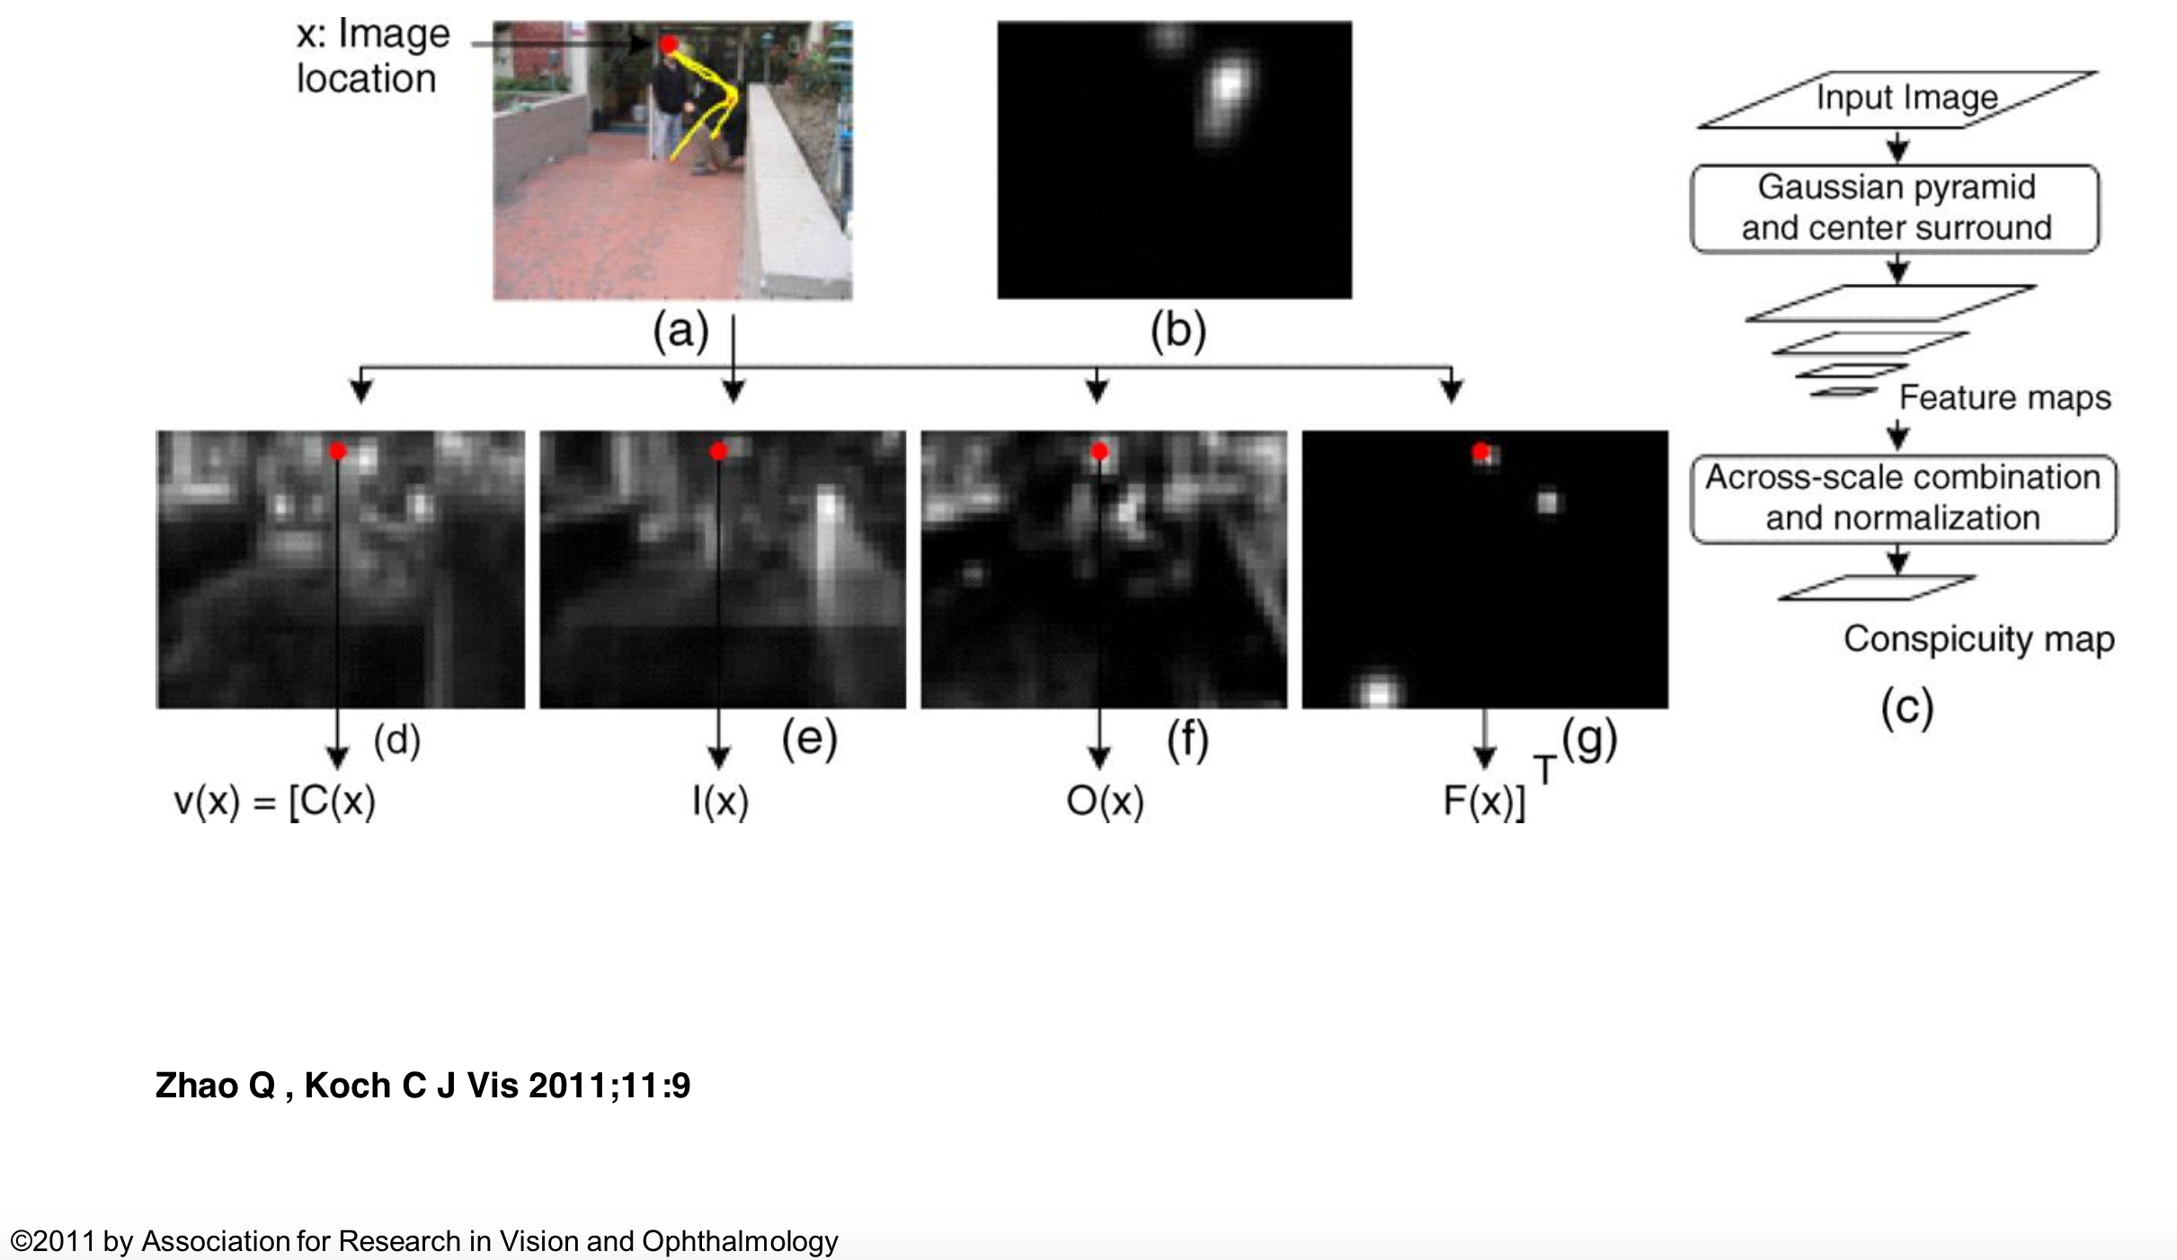
Graph-based Visual Saliency

Slide 13
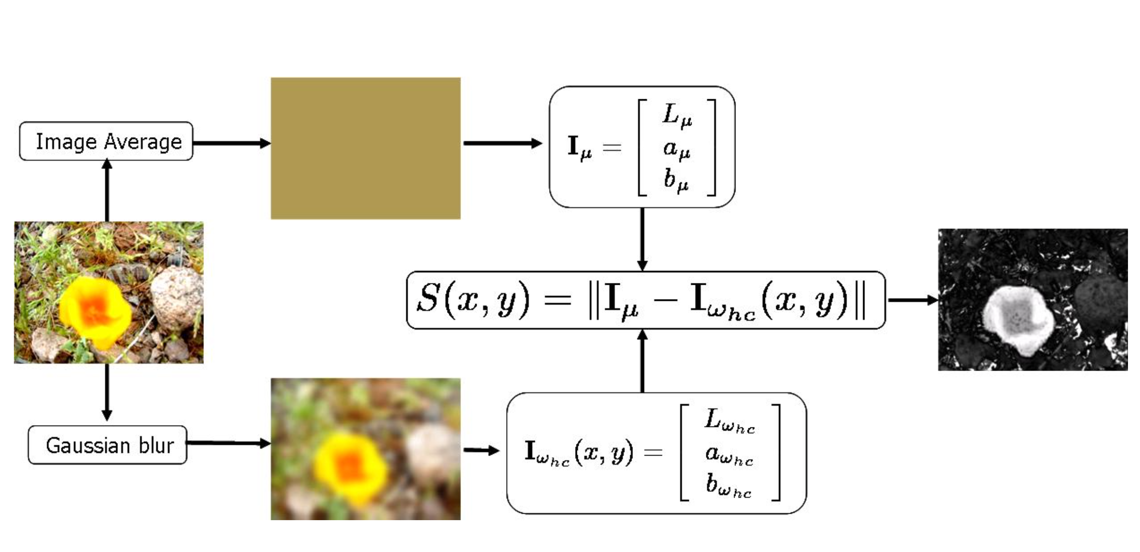
Image Mean-based Visual Saliency

Slide 14
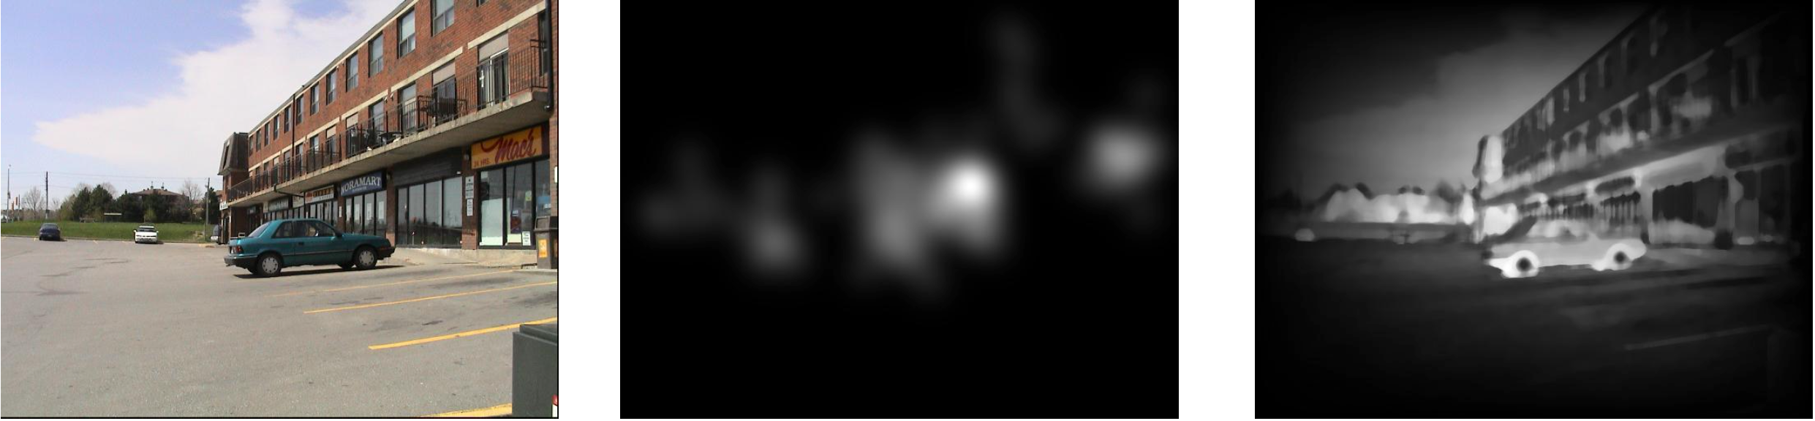
Experiments on Eye-Gaze data
Image Ground-Truth Fixation Density Saliency Map

Slide 15
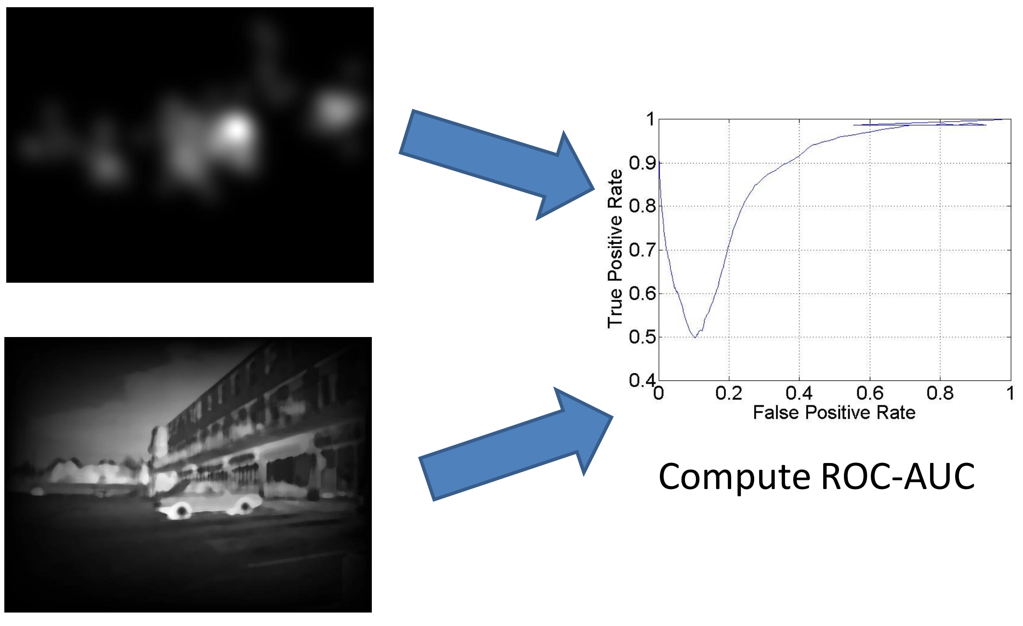
Experiments on Eye-Gaze data
[3]

Slide 16


Experiments on Salient Region Detection
Input Image Saliency Map Ground-Truth Detected Foreground
Compute F-measure

Slide 17
Summary: Saliency systems
For robotics applications use a light weight methods like Mean or Random contrast based saliency
Graph and Multiscale saliency are ideal for psychological experiment modelling
O(Mean) < O(Random) < O(Multiscale) < O(Graph)

Slide 18

References and test-sets
Microsoft Salient Object Dataset – 5000 Images
Berkley Salient Object Dataset – 300 Images
York University Eye Fixation Dataset – 120 Images
MIT Eye Fixation Dataset – 1003 Images

Slide 19
Anticipatory Gaze
anticipatory gaze has been shown to be connected to the Mirror Neurons system [4]
it presents a inside to the top-down component of visual attention mechanism:
cognitive process
anticipate a goal of an action

Slide 20
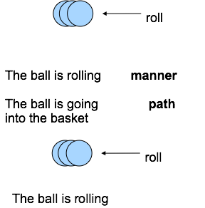
The concept of Manner and Path
children tend to learn verbs later than nouns (e.g., Choi & Bowerman,1991; Choi & Gopnik, 1995, but see Tardiff, 1996)‏
Building an arsenal of verbs requires more than just attaching labels to actions:
Infants must pay attention to the non-linguistic components of actions that words encode, such as path and manner.
Next, when actions meet words, they attach a label to these actions.
Finally, they begin to use these verbs productively in their grammar.
Notes:
complex understanding of language concepts connected to actions

Slide 21
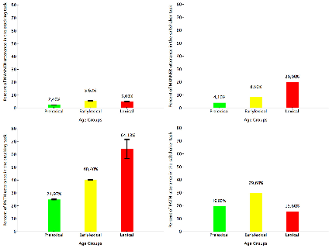
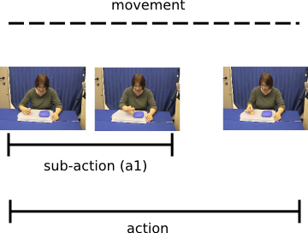
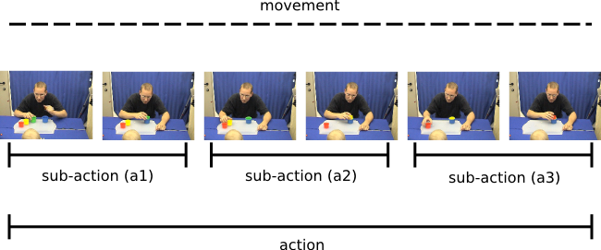
Language, action and eye gaze
Notes:
manner related task salt shacker
salt being shacked on a plate
path related stacking cups
cups stacked into an other on

Slide 22
Summary:Co-development [5]
in manner-oriented tasks, like the saltshaker task, parents name the object during an attention-getting gesture (looming action)
a looming detection could support keyword learning
lexical infants present more anticipatory gazing behaviour than early-lexical and pre-lexical infants, in a path-oriented task.
only in path-oriented tasks, an anticipatory gazing behaviour can be found, thus a robot should be able to distinguish these two concepts to give an appropriate feedback
Notes:
action language
keyword spotter
gazing language
anticipatory gaze

Slide 23
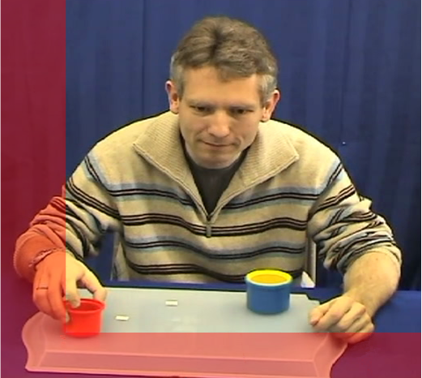
Detection of path and manner oriented actions

Slide 24
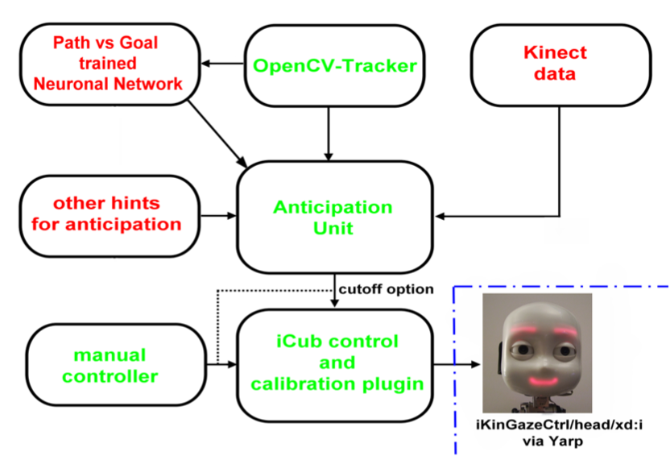
Detection of path and manner oriented actions

Slide 25
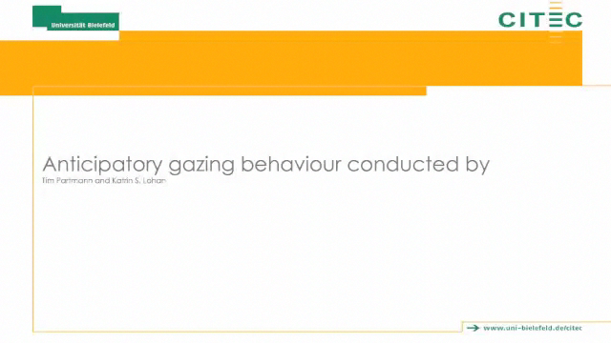
Anticipatory gaze

Slide 26
Summary: Anticipatory gaze
a first approach to anticipate a goal position by tracking the previous path of the object
distinguish manner- and path- oriented objects only by their trajectory, using a neural network
[Partmann MSc. 2011]

Slide 27
References
[1] Jonides, J. (1983). Further toward a model of the mind’s eye’s movement. Bulletin of the Psychonomic Society, 21(4), 247-250.
[2] ITTI, Laurent; KOCH, Christof; NIEBUR, Ernst. A model of saliency-based visual attention for rapid scene analysis. IEEE Transactions on pattern analysis and machine intelligence, 1998, 20. Jg., Nr. 11, S. 1254-1259.
[3] Vikram, T. N., Lohan, K. S., Tscherepanow, M., Rohlfing, K., & Wrede, B. Can state-of-the-art saliency systems model infant gazing behavior in tutoring situations?. Frontiers in Computational Neuroscience, DOI, 10.
[4] Elsner, C., D’Ausilio, A., Gredebäck, G., Falck-Ytter, T., & Fadiga, L. (2013). The motor cortex is causally related to predictive eye movements during action observation. Neuropsychologia, 51(3), 488–92. doi:10.1016/j.neuropsychologia.2012.12.007
[5] Lohan, K. S., Griffiths, S. S., Sciutti, A., Partmann, T. C., & Rohlfing, K. J. (2014). Co‐development of Manner and Path Concepts in Language, Action, and Eye‐Gaze Behavior. Topics in cognitive science, 6(3), 492-512.

